Slide 1
SC1015 Mini Project
Heart Disease Detection
DSF2
Created by:
Aloysius Ang Kirk Zhao (U2120520B)
Chia Jer Wen (U2120972F)
Hill Seah Wen Qi (U2121346H)
Notes:
Hello everyone, we are from DSF2 and this is our SC1015 mini project about heart disease detection. I am aloysius…

Slide 2

Table Of Contents
Sample Collection | Practical Motivation
Data Preparation | Problem Formulation
Exploratory Analysis | Statistical Description
Analytic Visualization | Pattern Recognition
Algorithmic Optimization | Machine Learning
Information Presentation | Statistical Inference
Notes:
This is our table of contents

Slide 3

Practical Motivation
Why Heart Disease?
Notes:
Why heart disease?
Our interest in heart disease came from one of the other modules we are taking, which taught that heart disease is one of the biggest killers in Singapore. This led us to research deeper to find out the significance of heart disease

Slide 4

Heart Disease in Singapore and the World
2rd main cause of death in Singapore
Leading cause of death in the U.S.
Leading cause of death Globally
18.8% Total Deaths in 2019
4,031 deaths
20.6% Total Deaths in 2020
697,000 deaths
32% Total Deaths in 2019,
17.9 million deaths
Notes:
We found that heart disease is the 2rd main cause of death in singapore, with 4031 deaths and accounting for 18.8% total deaths in 2019. It is also the leading cause of death in the US and the world

Slide 5
Importance of Early Detection
40% of adults were unaware they had heart disease
Early detection leads to early intervention, which reduces suffering and prevents complications such as heart failure, stroke and kidney disease
Early intervention also increases the chances of recovery
Notes:
Over the years, doctors emphasized the importance of early detection. Around 40% of adults were unaware they had heart disease and missed the chance for early treatment. Early detection leads to early intervention, which reduces suffering and prevents complications such as heart failure, stroke and kidney disease. Early intervention also increases the chances of recovery. Thus, we aim to increase early detection among patients which leads to our problem statement:

Slide 6
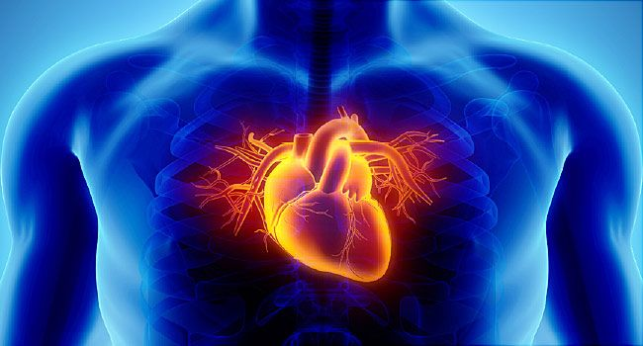
The problem:
How to accurately predict heart disease for early prediction and intervention?

Slide 7

Data
Sampling
Notes:
To answer our problem, we found a dataset

Slide 8

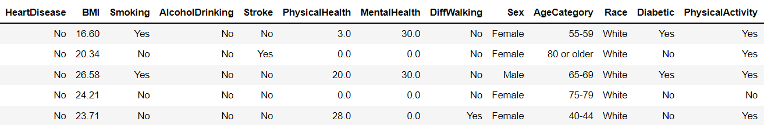
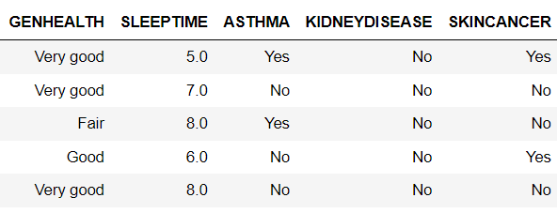
Our Dataset:
:
https://www.kaggle.com/datasets/kamilpytlak/personal-key-indicators-of-heart-disease
Size of Data: 319,795
Response Variable: Heart Disease (Yes/ No)
Notes:
Our data is sourced from kaggle, and has a size of around 320,000. Our response variable is heart disease, and is a boolean value. The predictor variables are those in the blue boxes, which are the other variables in the image

Slide 9

Exploratory
Data Analysis

Slide 10
Understand
the Data
Clean
the Data
Analyse
the Relationship

Slide 11

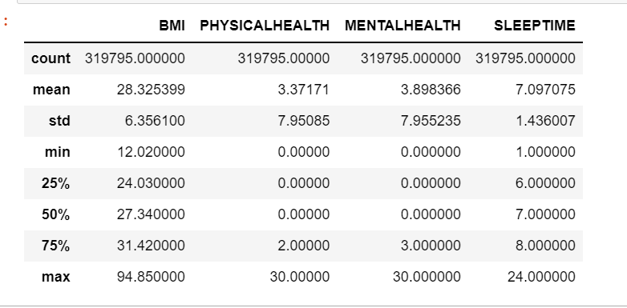
Overview summary
of Numeric Predictors
Understand
the Data

Slide 12
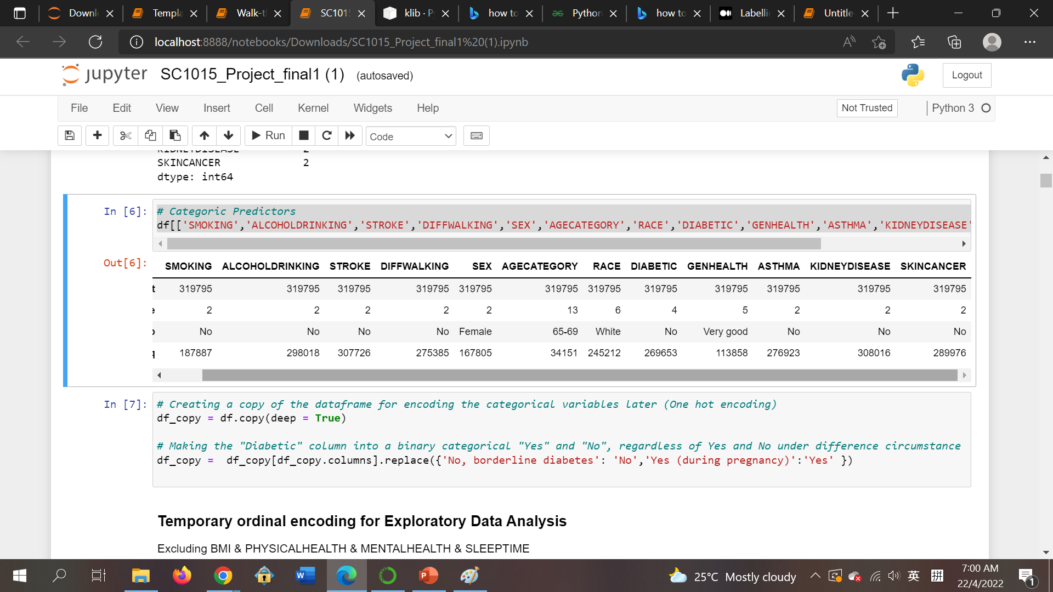
Overview summary of Categorical Predictors
Understand
the Data
count
unique
top
freq

Slide 13
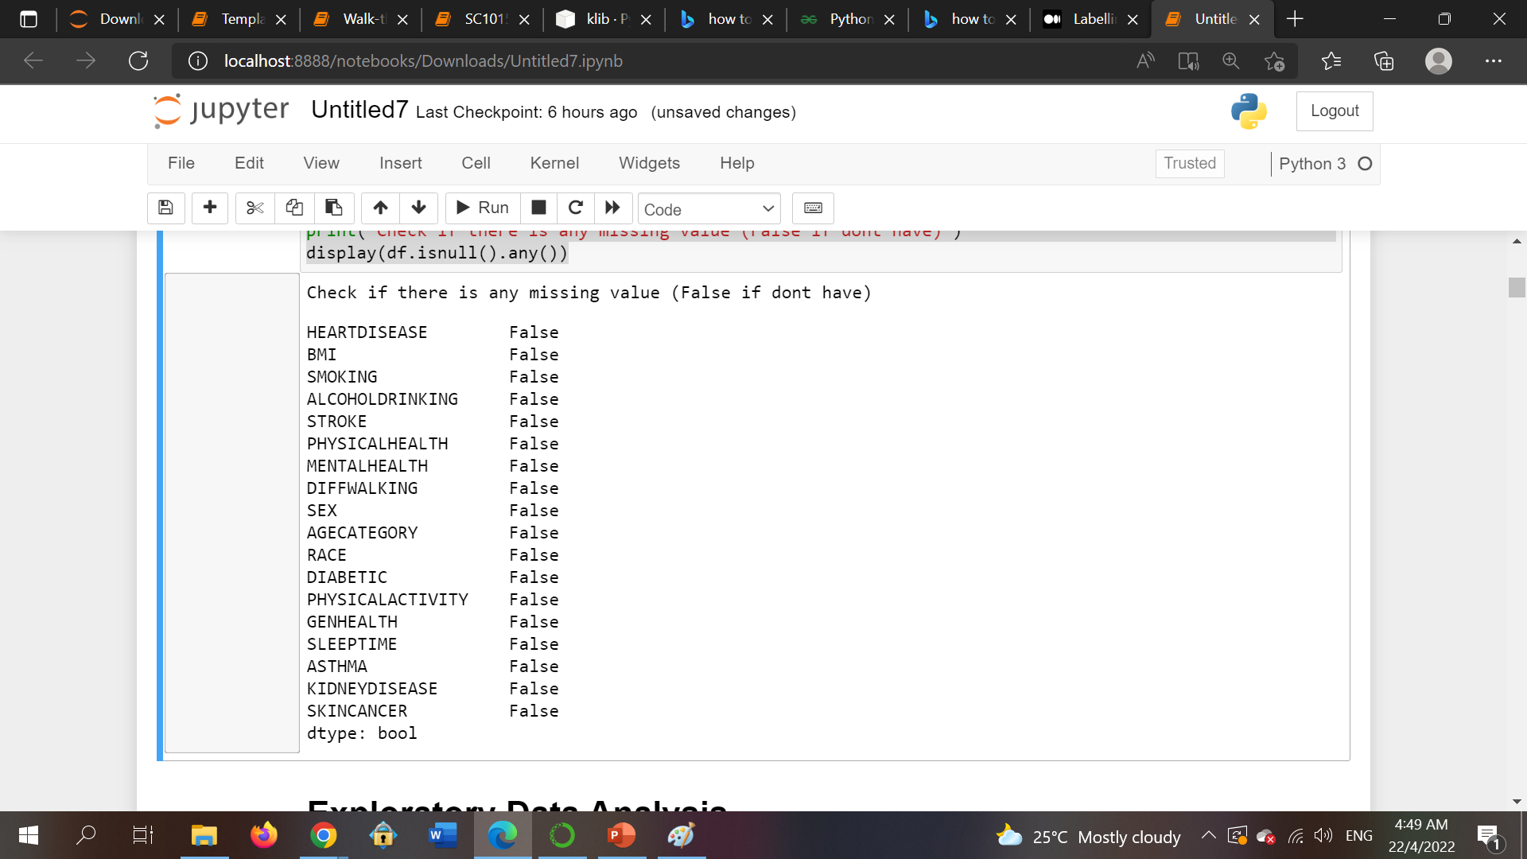
Clean
the Data
No Missing Value !!

Slide 14
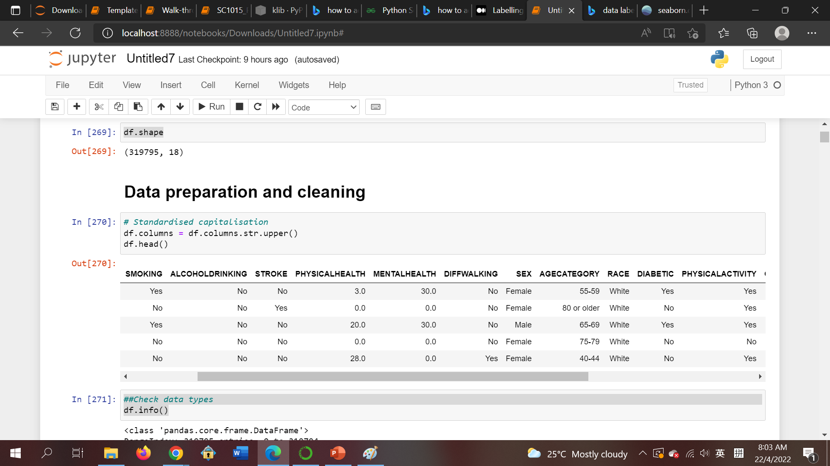
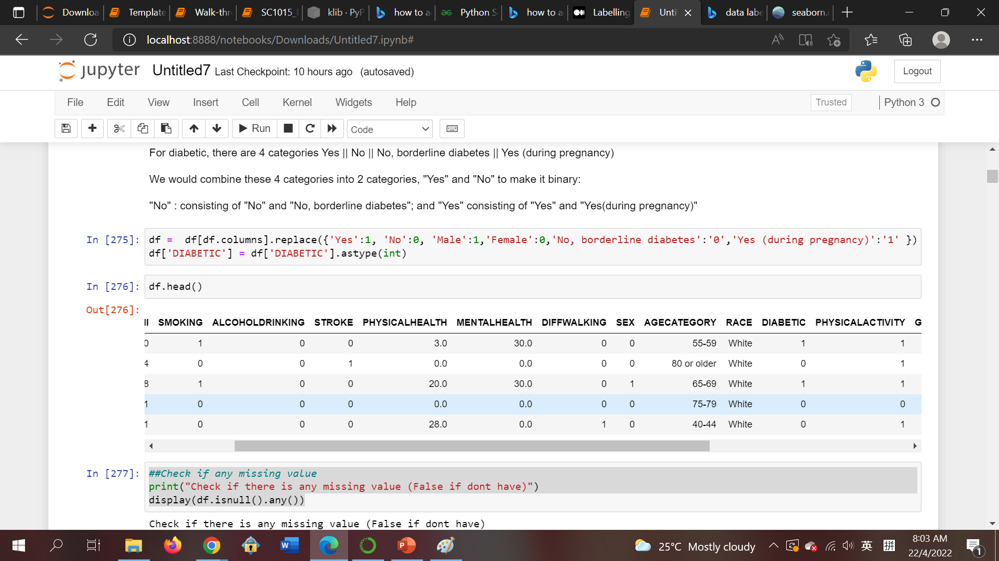
Yes—>1
No—>0
Clean
the Data
Male—>1
Female—>0

Slide 15
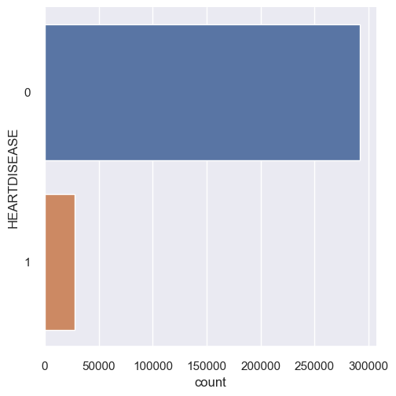
Cardinality of Categorical Variables
Univariate
Analysis
292422
27373
Imbalance

Slide 16
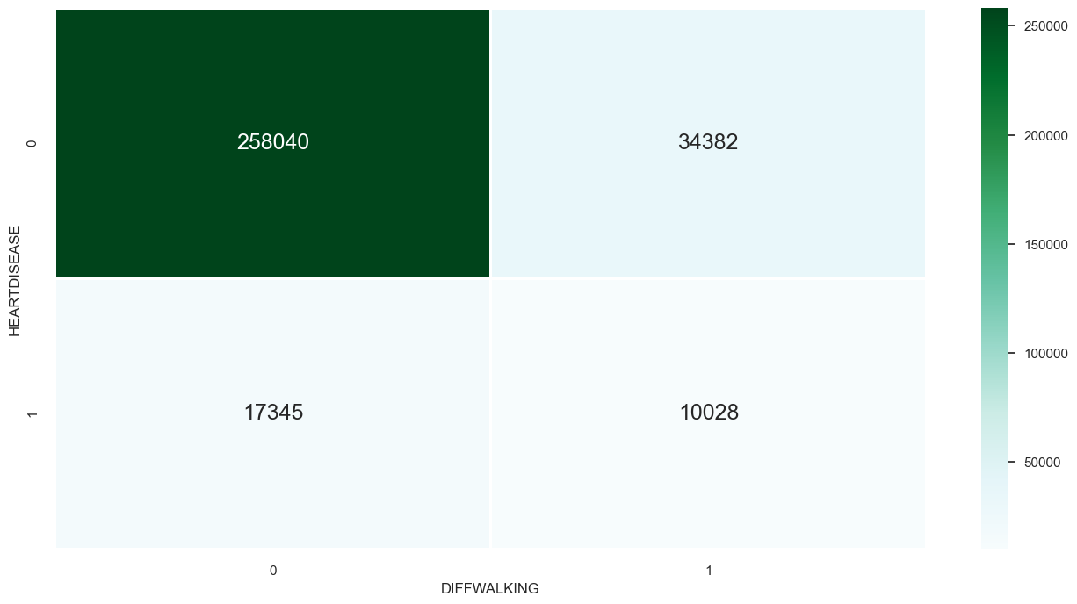
Analysing the relationship between difficult in walking AND heart disease
Bivariate
Analysis

Slide 17
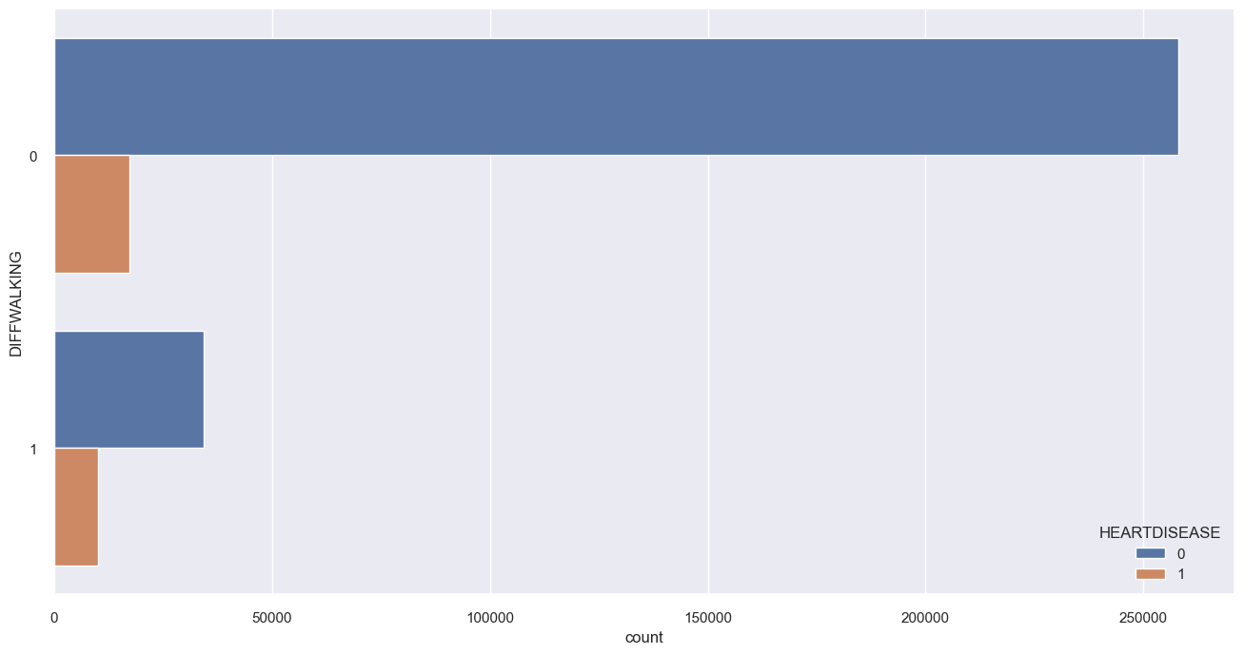
Analysing the relationship between difficult in walking AND heart disease
Bivariate
Analysis
Number of people who has/no
heart disease according to gender
258040
17345
34382
10028

Slide 18
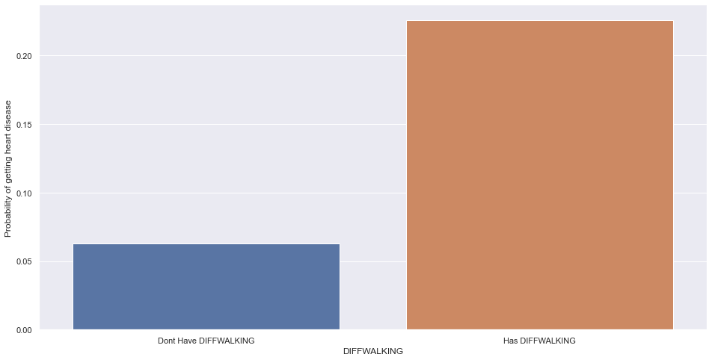
Analysing the relationship between difficult in walking AND heart disease
Bivariate
Analysis
22.6%
6.3%

Slide 19
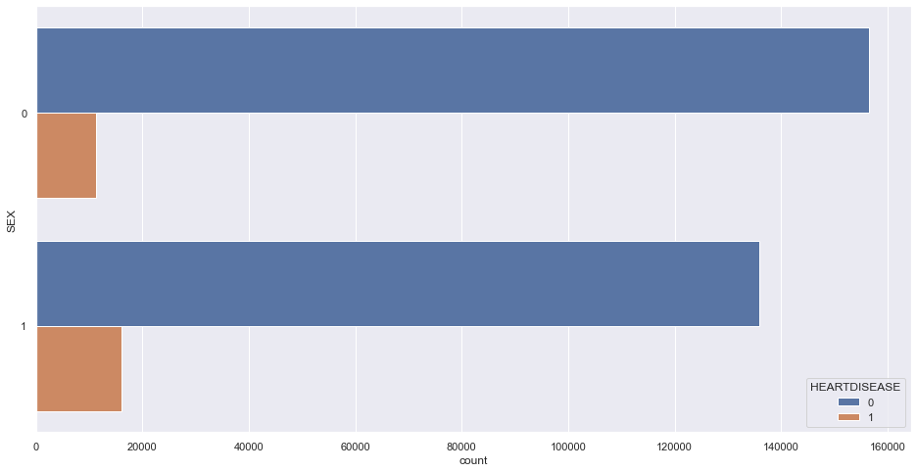
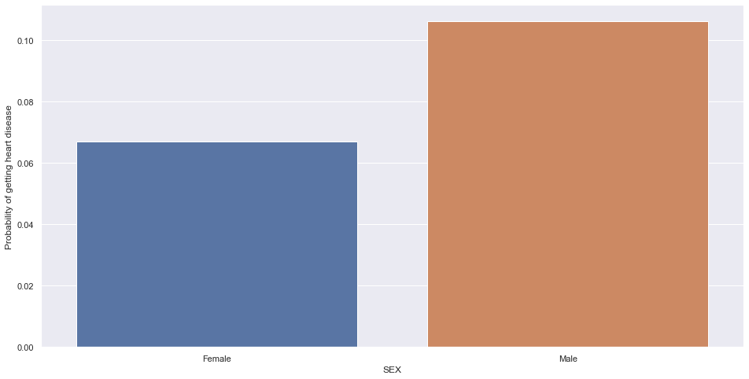
Analysis between gender and heart disease
Multivariate
Analysis
Number of people who has/no
heart disease according to gender
Probability of having
heart disease according to gender
156571
F
11234
10.6%
135851
6.7%
M
16139

Slide 20
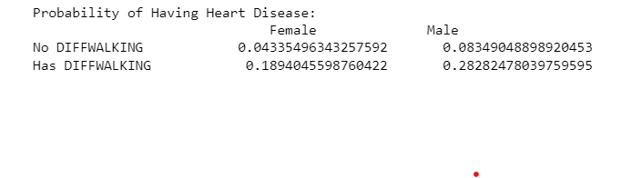
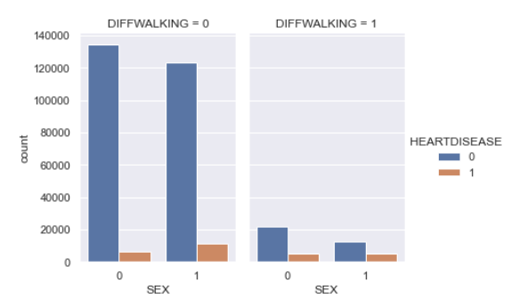
Multivariate
Analysis
134599
123441
21972
11245
12410
6100
5134
4894

Slide 21

Data Preprocessing
Encoding
Resampling
Notes:
Our interest in heart disease came from one of the other modules we are taking, which taught us the biggest killers in Singapore, and heart disease being one of them. This led us to research deeper to find out the significance of heart disease

Slide 22
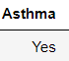
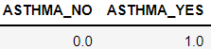
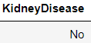
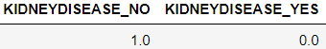
Encoding (One Hot Encoder)
Some machine learning models require numeric data for categorical predictor variables to operate
One Hot Encoder is used to convert our categorical data in the predictor variables into numeric data for machine learning
For Example:
Categorical data
Numeric data
Encoding
Encoding

Slide 23
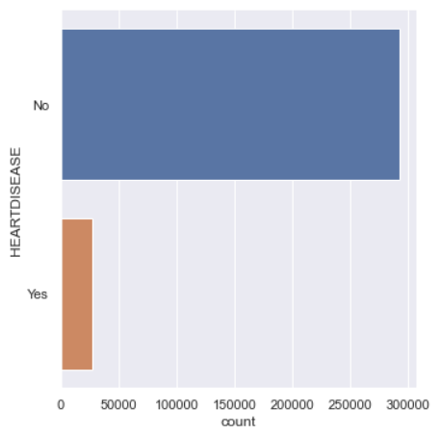
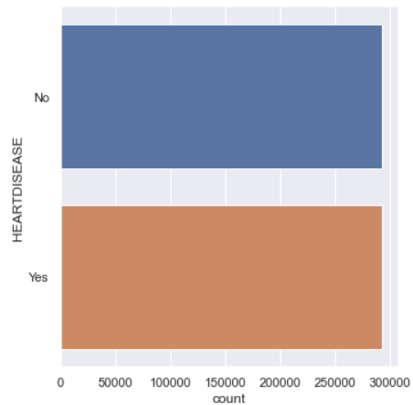
Resampling
Upsampling - randomly duplicates datasets in the minority ”Yes“ classes to match the number of majority ”No“ classes for the response variable ”HeartDisease“
Severely Imbalanced Data
Upsampled Balance Data
292422
292422
Upsampling
27373
292422

Slide 24
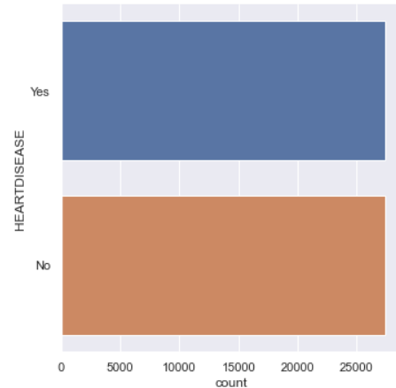
Resampling
Downsampling - randomly deletes examples in the majority ”No“classes to match the minority ”Yes “classes for the response variable ”HeartDisease“
Severely Imbalanced Data
Downsampled Balance Data
292422
27373
Downsampling
27373
27373

Slide 25

Machine Learning
Decision Tree
Random Forest
Grid Search
Notes:
Our interest in heart disease came from one of the other modules we are taking, which taught us the biggest killers in Singapore, and heart disease being one of them. This led us to research deeper to find out the significance of heart disease

Slide 26
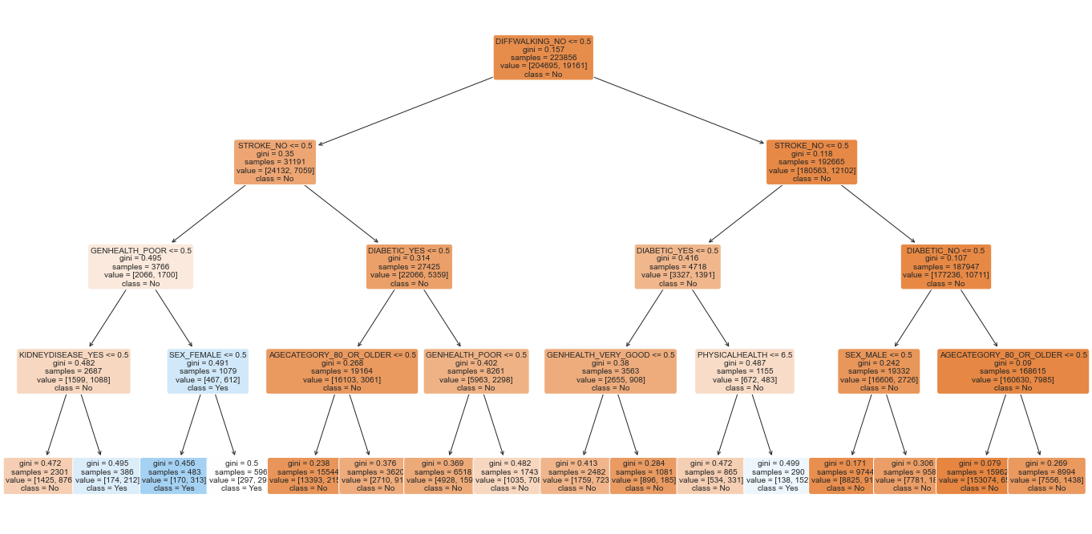
Decision Tree
Decision tree model of depth 4 was created to classify our response variable ”HeartDisease“

Slide 27
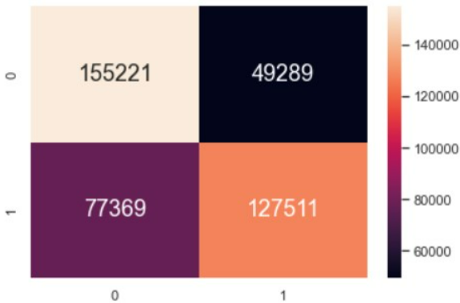
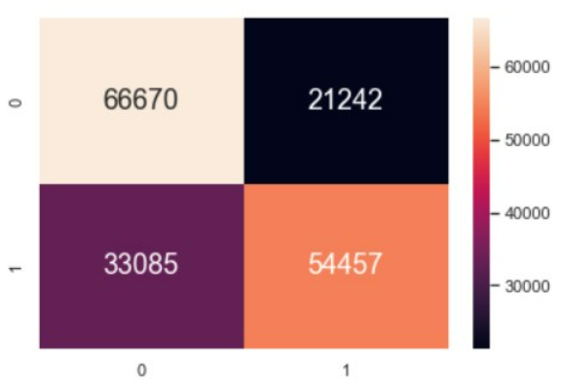
Decision Tree
TRAIN SET
Classification Accuracy: 0.691
True Positive Rate: 0.622
True Negative Rate: 0.759
False Positive Rate: 0.241
False Negative Rate: 0.378
TEST SET
Classification Accuracy: 0.690
True Positive Rate: 0.622
True Negative Rate: 0.758
False Positive Rate: 0.242
False Negative Rate: 0.378

Slide 28
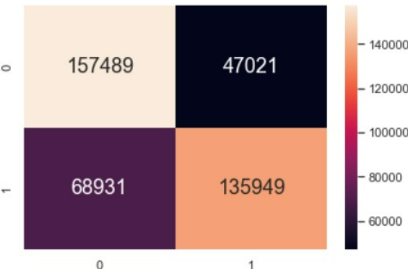
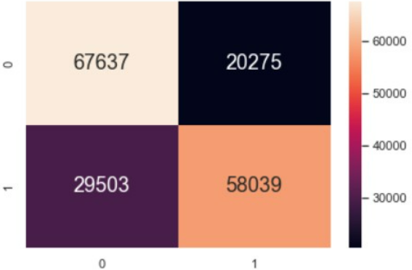
Random Forest
Improvements: 1. Classification Accuracy increased from 69% to around 72%
2. False negative rates fell from 38% to around 34%
TRAIN SET
Classification Accuracy: 0.717
True Positive Rate: 0.664
True Negative Rate: 0.770
False Positive Rate: 0.230
False Negative Rate: 0.336
TEST SET
Classification Accuracy: 0.717
True Positive Rate: 0.663
True Negative Rate: 0.769
False Positive Rate: 0.231
False Negative Rate: 0.337

Slide 29
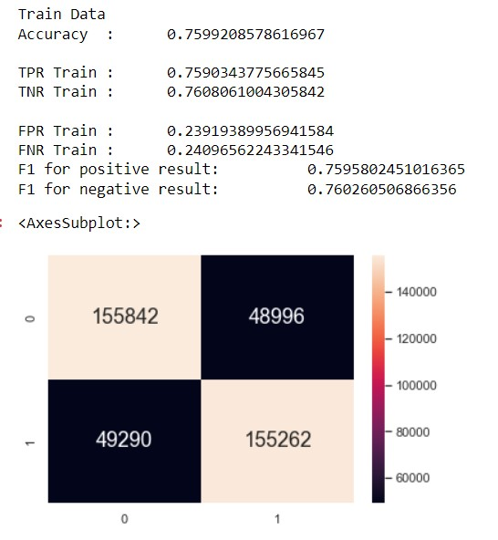
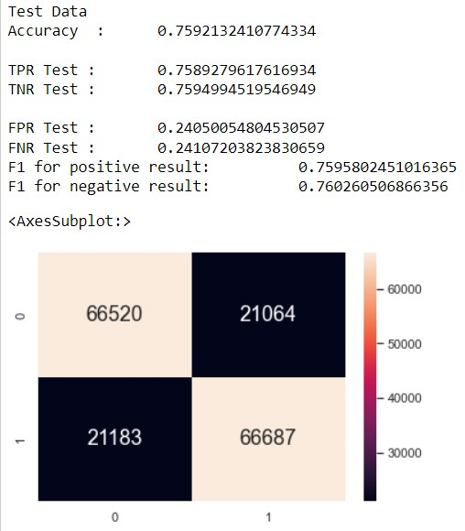
Grid Search (Cross Validation)
Improvements: 1. Classification Accuracy increased from 72% to around 76%
2. False negative rates fell from 34% to around 24%
TRAIN SET
Classification Accuracy: 0.760
True Positive Rate: 0.759
True Negative Rate: 0.761
False Positive Rate: 0.239
False Negative Rate: 0.241
TEST SET
Classification Accuracy: 0.759
True Positive Rate: 0.759
True Negative Rate: 0.760
False Positive Rate: 0.241
False Negative Rate: 0.241
Notes:
How do we improve further? We could increase the number of trees and their depth, but this may lead to overfitting, and cause our model to be ineffective with test data. Hence, finding the optimal hyper-parameters to maximize accuracy is vital, and to do that, we will use grid search (NEXT). There are improvements in classification accuracy and false negative rate after conducting grid search

Slide 30
Machine Learning
Downsampled Dataframe
Notes:
We will perform the same techniques for the downsampled dataframe

Slide 31
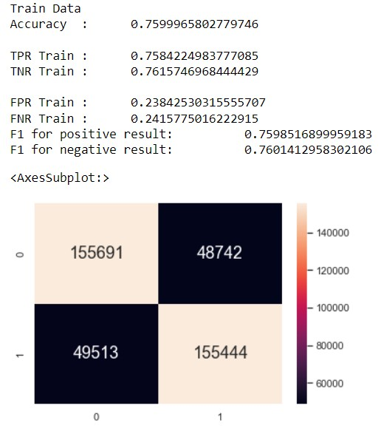
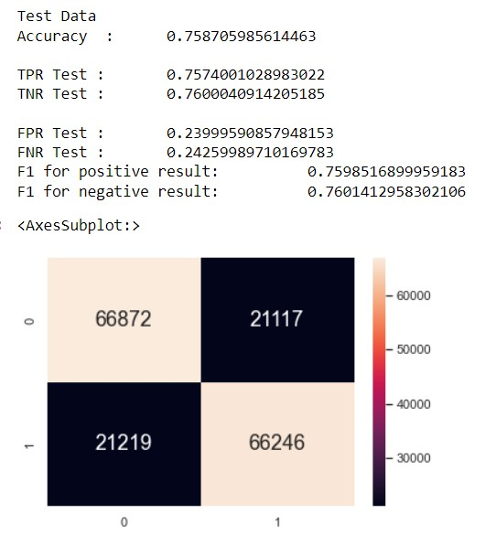
Grid Search (Cross Validation) for downsampled data
TRAIN SET
Classification Accuracy: 0.760
True Positive Rate: 0.758
True Negative Rate: 0.762
False Positive Rate: 0.238
False Negative Rate: 0.242
TEST SET
Classification Accuracy: 0.759
True Positive Rate: 0.757
True Negative Rate: 0.760
False Positive Rate: 0.240
False Negative Rate: 0.243
Notes:
These are the results for grid search on downsampled data

Slide 32
Analysis of Results
Comparison: 1) Classification accuracy for both are almost the same at
76%
2) False negative rate for downsampled data is higher at
24.3% as compared to 24.1% for upsampled data
3) True positive rate for upsampled data is higher at
75.9% as compared to 75.7% for downsampled data
4) True negative and false positive rates are better for
downsampled, but they are not as significant as true
positive and false negative rates
The better model is one which reduces false negative rate and gives higher true positive rate
The upsampled data may be better, however slight
Notes:
Comparison… (read off slides)
(NEXT) Since we are trying to increase early detection, increasing the true positive rate and reducing the false negative rates are our priority. We want to reduce false negatives as much as possible as these results will mislead patients into thinking that they don’t have heart disease but in reality they do, and thus missing the opportunity for early treatment. (NEXT) Thus, the upsampled data may be better, however slight

Slide 33

Outcomes and Lessons Learnt
Notes:
Outcomes and lessons learnt

Slide 34
Lessons Learnt:
Encoding and Resampling
Random Forest
Grid Search (Cross-validation)
Outcomes:
Hospitals and doctors can predict whether a patient has or is going to have heart disease using the other health-related variables
Increase early detection
Interesting observations:
May not be possible to reduce both false negative and false positive rates
Vital to choose which to prioritize improving
Notes:
We learnt encoding and resampling to better prepare our data, and random forest and grid search to improve our machine learning models
Using our model, hospitals and doctors can predict whether a patient has or is going to have heart disease, and this increases early detection
Lastly, we found out that it may not be possible to reduce both the false negative and false positive rates. Thus, it is vital to choose which to prioritize to improve

Slide 35
Data-driven Insights
Increase early treatment
Patients who detected heart disease early can go for early treatment and increase chances of recovering
Lower medical costs
With early treatment, operations and surgeries are less likely to be needed for the patient to recover
Lower hospital demands
Early treatment prevents heart disease and allows patients to recover on their own, reducing the need to stay at hospitals
Increase survivability
Early detection leads to early intervention which saves lives
Notes:
In conclusion, our project seeks to:
Increase early treatment, lower medical costs, lower hospital demands and most importantly, increase survivability

Slide 36
Thank You!
Notes:
And with that, we have come to the end of our presentation. Thank you for watching!

